Slide 1
Community Council webinar
22 March

Slide 2
Independent & advisory body
provides guidance and advice on sentencing matters
provides sentencing guidelines for the courts

Slide 3
The Council
Six judicial members
Three legal members – advocate, solicitor, prosecutor
One police constable
One person with knowledge of victims’ issues
One other person – who is not another judge – currently academic

Slide 4
The Judge

Slide 5
Guidelines in force
Principles and Purposes of Sentencing
The Sentencing Process
Sentencing Young People

Slide 6
Sentencing guidelines assist
judges in making challenging decisions
consistency & predictability in sentencing across Scotland

Slide 7
Developing Guidelines
conduct research - including on guidelines in other jurisdictions
interview judges
look at public perceptions
gather criminal justice data
engage with interest groups
consult widely - including with public
Current consultations are on our website

Slide 8
Principles and Purposes guideline (not ordered or exhaustive)
Protection of the public
Punishment
Rehabilitation of offenders
Giving the offender the opportunity to make amends
Expressing disapproval of offending behaviour

Slide 9
Determine seriousness
culpability of offender
harm caused or which could have been caused to victim

Slide 10
Levels of seriousness

Slide 11
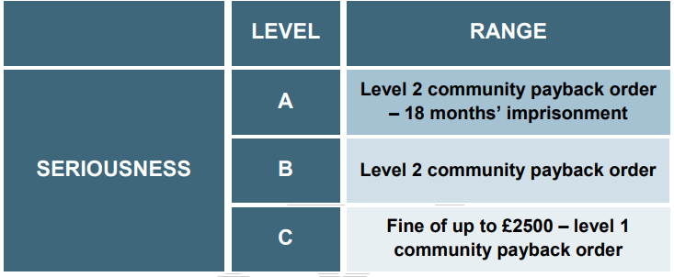
Sentencing levels

Slide 12
Factors in sentencing
 | Aggravating | Mitigating
Consequences | More than one person killed
 | Serious injury caused to another person or persons (excluding the driver | Driver sustained serious injury
Record and circumstances of driver | Relevant previous convictions (not necessarily limited to convictions for road traffic offences) | Deceased was family member or close friend of driver
 |  | Remorse
 |  | Previous good driving record
 |  | Driving while inexperienced
Circumstances of offence and actions at the scene | Other offences committed at the same time (such as driving while disqualified or without insurance, or leaving the scene of the offence with a view to evading detection) | Providing assistance at the scene
 |  | Driving in an emergency, whether in a designated emergency vehicle or otherwise
 |  | Involuntary intoxication due to alcohol or drugs
 |  | The actions of the victim or a third party contributed significantly to the likelihood of a collision occurring and/or death resulting

Slide 13
The Sentencing Process

Slide 14
Young people research
may not have full maturity – leads to lower culpability
may have greater potential to change

Slide 15
Sentencing young people
Emphasis on rehabilitation
This does not
prevent imprisonment if crime is serious enough

Slide 16
Sentencing Young People guideline
Individualised Approach
Take into account
level of maturity
circumstances
background
(impact of trauma and adverse childhood experiences)

Slide 17
community payback order with a requirement for unpaid work of around 250 hours, and disqualified the offender from driving for a year.

Slide 18
Guidelines not followed
cases where appropriate not to follow
judges must give reason

Slide 19
Website
Sentencing young people video
what sentences are available to judges
what the law says
interactive case studies where you play the role of judge
series of videos including on sentencing young people
myth and jargon busters

Slide 20
High end community payback order
up to 300 hours of unpaid work - equivalent of 6 hours a day for 50 days
2 years of regular meetings with a social worker aimed at changing offending behaviour
a programme to address an issue such as drug use
compensation payment made to victim

Slide 21
Community Sentences
research shows people see as lenient
however, overall people agree with sheriffs in specific case scenarios

Slide 22
Headlines - research
headlines can influence perception
‘avoids jail’ – impression of leniency
Community sentences can be very challenging - even more challenging than a short prison sentence

Slide 23
Contact us
scottishsentencingcouncil.org.uk
sentencingcouncil@scotcourts.gov.uk
@ScotSentencing / LinkedIn

